Slide 1
AIU-SZ CONFERENCE OF VICE-CHANCELLORS
Jan 31, 2023
PROMOTING QUALITY & RELEVANT RESEARCH
By
Dr. S .VAIDHYASUBRAMANIAM
VICE-CHANCELLOR
& TATA SONS CHAIR PROFESSOR OF MANAGEMENT
E-mail: vaidhya@sastra.edu

Slide 2
EVERY COUNTRY HAS ITS PROBLEMS, THAT DOESN’T MAKE IT A PROBLEMATIC COUNTRY

Slide 3
MOVE FROM YOUR ‘KODAK’ MOVEMENT TO EXPLORE YOUR ‘EUREKA’ MOMENT

Slide 4
ACADEMIC GINI IS AS PREVALENT AS ECONOMIC GINI – UNDERSTAND YOUR ACADEMIC GINI?

Slide 5
COLLABORATIVE COMPETITION AND CO-INNOVATION

Slide 6
IDEO VENN FOR INNOVATION

Slide 7
INTELLECTUAL PARATROOPING vs FOOT SOLDIERING

Slide 8
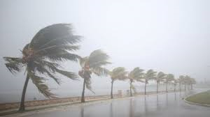
The Winds of Change are blowing hard – What Next?
Best Build Windmills
The Rest sleep under shelter

Slide 9
THANK YOU

